Slide 1
Analysis and Design of algorithms
Fundamentals of Computer Algorithms
Authors: Horowitz Ellis & Sahni Sartaj
Publication: Galgotia Pub. Pvt. Ltd.

Slide 2
What is an Algorithm
An algorithm is a finite set of instructions that if followed, accomplishes a particular task.
  In a computer terminology, algorithm is a method that computer can use for solving problem.
An algorithm is said to be recursive if the same algorithm is invoked in the body.
  An algorithm that calls itself is direct recursive.
  An algorithm A is said to be indirect recursive if it calls another algorithm which in turn calls A.
Program is the expression of an algorithm in a programming language.

Slide 3
Criteria for designing an algorithm
Input: Zero or more quantities are externally supplied.
Output: At least one quantity is produced.
Definiteness: Each instruction is clear and unambiguous.
  “add 6 or 7 to x” is not valid, it should be definite.
Finiteness: If we trace out the instructions of an algorithm, then for all cases, the algorithm should terminate after a finite number of steps.
  The time for termination should be short
Effectiveness: Every instruction must be very basic so that it can be carried out by a person using only pencil and paper (in finite amount of time)
Algorithms that are definite and effective are also called computational procedures. For example, Operating Systems

Slide 4
Pseudo code Conventions
In computational theory, we distinguish between an algorithm and a program.
  The program does not have to satisfy the finiteness condition.
  For example, we can think of an operating system that continues in a “wait” loop until more jobs are entered.
Most of the algorithms use a pseudocode that resembles C and Pascal.

Slide 5
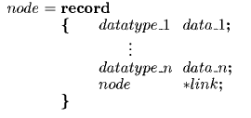
Pseudo code Conventions
Comments begin with //
Blocks are indicated with matching braces: { and }
Statements are delimited by ;
An identifier begins with a letter
Compound data types can be formed with records

Slide 6
Pseudo code Conventions
Assignment of values to variables is done using the assignment statement
Boolean values, logical operators, and relational operators are provided as they are.
Elements of multi dimensional array are accessed using [ and ]. For example, A[i,j].

Slide 7
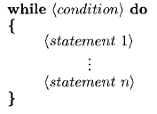
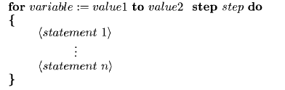
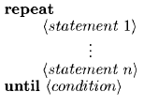
Pseudo code Conventions
The forms of while, for, and repeat-until are as follows.

Slide 8

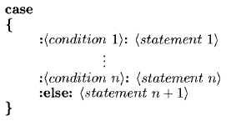
Pseudo code Conventions
A conditional statement has the following forms:

Slide 9
Pseudo code Conventions
Input and output are done using the instructions read and write. No format is used to specify the size of input or output quantities.
there is only one type of procedure Algorithm. An algorithm consists of a heading and a body. The heading takes the form
The body has one or more statements enclosed within braces.
An algorithm may or may not return value.
Arrays and records are passed by reference.

Slide 10
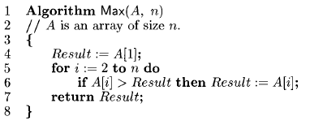
Sample Algorithm
The following algorithm finds and returns the maximum of n given numbers.
In this algorithm named Max, A and n are procedure parameters, Result and i are local variables.

Slide 11
Criteria for judgment of an algorithm
Does it do what we want it to do? i.e. does it work correctly?
Does it work correctly according to the original specification of the task? i.e. does it do all specified task?
Is there any documentation that describes how to use it and how it works? i.e. if it is documented properly?
Are procedures created in such a way that they perform logical subfunctions? i.e. is algo. modular?
Is the code readable?

Slide 12
Writing The First Algorithm
Problem: Suppose we have to write an algorithm that sorts a collection of n>=1 elements of arbitrary type.
Simple Solution: (Selection Sort) From those elements that are currently unsorted, find the smallest and place it next in the sorted list.
  Although this statement adequately describes the sorting problem, it is not an algorithm because it leaves several question unanswered.
    Where and how the elements are initially stored
    Where we should place the result
  We assume that the elements are stored in an array a, such that the ith integer is stored in the ith position a[i], 1<= i <= n.

Slide 13
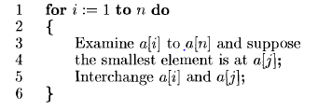
Writing The First Algorithm
Initial Algorithm
To turn above algorithm into a pseudocode program, two clearly defined subtasks remain:
  Finding the smallest element (say a[j])
  Interchanging it with a[i]

Slide 14
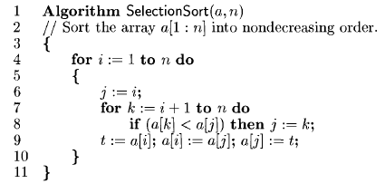
Writing The First Algorithm

Slide 15
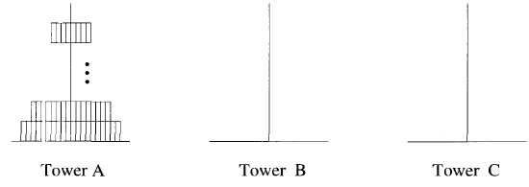
Recursive Algorithms
An algorithm is said to be recursive if the same algorithm is invoked in the body.
  An algorithm that calls itself is direct recursive.
  An algorithm A is said to be indirect recursive if it calls another algorithm which in turn calls A.
Example: Tower of Hanoi Problem:

Slide 16
Recursive Algorithms
The Tower of Hanoi (also called the Tower of Brahma or Lucas' Tower and sometimes pluralized) is a mathematical game or puzzle.
It consists of three rods and a number of disks of different sizes, which can slide onto any rod.
The puzzle starts with the disks in a neat stack in ascending order of size on one rod, the smallest at the top, thus making a conical shape.
The objective of the puzzle is to move the entire stack to another rod, obeying the following simple rules:
  Only one disk can be moved at a time.
  Each move consists of taking the upper disk from one of the stacks and placing it on top of another stack.
  No disk may be placed on top of a smaller disk.
With 3 disks, the puzzle can be solved in 7 moves.
The minimal number of moves required to solve a Tower of Hanoi puzzle is 2^{n} − 1, where n is the number of disks.

Slide 17
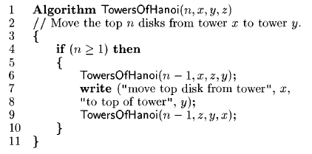
Algorithm for Tower of Hanoi

Slide 18
Space Complexity
The space complexity of an algorithm is the amount of memory it needs to run to completion.
The space needed by each algorithm is seen to be the sum of the following components:
  A fixed part: it is independent of the characteristics (e.g. Number, size) of the inputs and outputs.
    This part includes the space for code, space for simple variables, space for constants, etc.
  A variable part: it consists of the space needed by component variables whose size is depended on the particular problem instance being solved, the space needed by referenced variables , and the recursion stack space.
The space requirement S(P) of any algorithm P may be written as S(P) = c + Sp(instance Characteristics), where c is constant.
    While analyzing space complexity we solely focus on Sp

Slide 19
Time Complexity
The time T(P) taken by a program P is the sum of the compile time and the run time.
The compile time does not depend on the instance characteristics.
We focus on just run time of a program while considering time complexity.
The run time is denoted by tp (instance characteristics)

Slide 20
Time Complexity
A program step is loosely defined as a syntactically or semantically meaningful segment of a program that has an execution time that is independent of the instance characteristics.
We can determine the number of steps needed by a program to solve a particular problem (i.e. step count) instance in one of two ways:
  We can introduce a new variable , count, into the program. This is a global variable initialized to 0. each time a statement in the original program is executed, count, is incremented by the step count of that statement.
  Second method to determine the step count of an algorithm is to build a table in which we list the total number of steps contributed by each statement.
    This figure is often arrived at by first determining the number of steps per execution (s/e) of the statement and the total number of times each statement is executed (frequency).

Slide 21
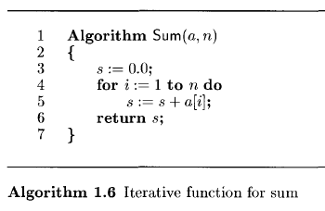
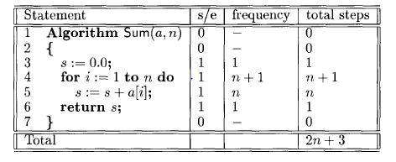
Calculating Time Complexity

Slide 22
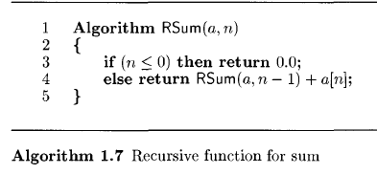
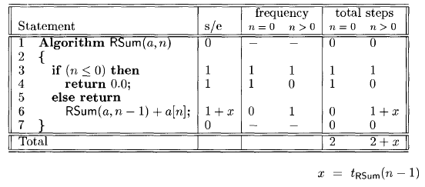
Calculating Time Complexity

Slide 23
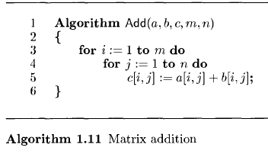
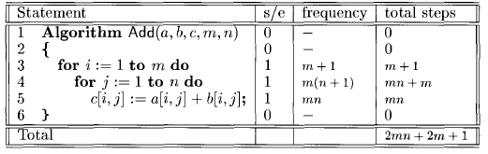
Calculating Time Complexity

Slide 24
Time Complexity
The examples seen were simple that the time complexities were functions of simple characteristics such as number of inputs and the number of rows and columns.
For many algorithms, the time complexity is not dependent solely on above mentioned characteristics. For example, searching algorithm.
The main objective of above examples are
  to compare the time complexities of two algorithms that computes the same function.
  To predict the growth in run time as the instance characteristics change.

Slide 25
Types of Step Counts
If sufficient amount of parameters are not available to calculate exact step count we have following options to get nearby result.
  Best case step count:
    It is the minimum number of steps that can be executed for the given parameters.
  Worst case step count:
    It is the maximum number of steps that can be executed for the given parameters.
  Average step count:
    It is the average number of steps that can be executed for the given parameters.

Slide 26
Asymptotic notations
Asymptotic notations are terminologies that enable us to make meaningful statements about the time and space complexity of an algorithm.

Slide 27

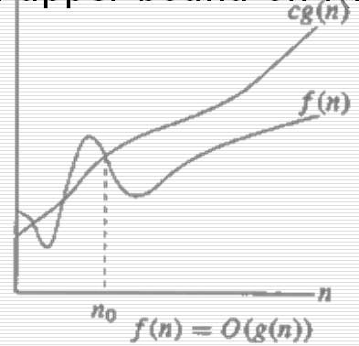
Big “oh”
Example:
3n + 2 = O(n)
3n + 2 ≤ 4n for all n ≥ 2.
3n + 3 = O(n)
3n + 3 ≤ 4n for all n ≥ 3.
100n + 6 = O(n)
100n + 6 ≤ 101n for all n ≥ 6.

Slide 28
Big “oh”
O(1) – constant computing time
O(n) – linear
O(n²) – quadratic
O(n³) – cubic
O(2^{n}) – exponential
O(1)
O(log n)
O(n)
O(n log n)
O(n²)
O(n³)
O(2^{n})
faster

Slide 29
Big “oh”
The statement f(n) = O(g(n)) states only that g(n) is an upper bound on the value of f(n) for all n, n ≥ no.
f(n) = O(g(n)) is not the same as O(g(n)) = f(n).
The statement f(n) = O(g(n)) to be informative, g(n) should be as small a function of n as one can come up with for which f(n) = O(g(n)).
So, though 3n + 3 = O(n²) is correct, we always state 3n + 3 = O(n).

Slide 30
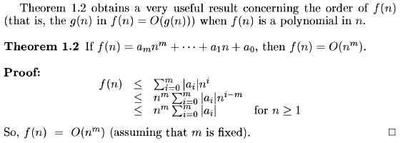
Theorem

Slide 31

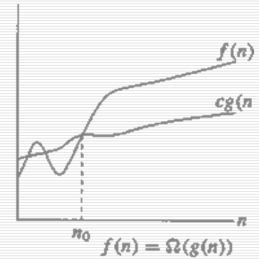
Omega Notation (Ω)
Example:
3n + 2 = Ω(n)
  3n + 2 ≥ 3n for all n ≥ 1.
3n + 3 = Ω(n)
  3n + 3 ≥ 3n for all n ≥ 1.
100n + 6 = Ω(n)
  100n + 6 ≥ 100n for all n ≥ 0.

Slide 32
Omega Notation (Ω)
The statement f(n) = Ω(g(n)) states only that g(n) is only a lower bound on the value of f(n) for all n, n ≥ no.
The statement f(n) = Ω(g(n)) to be informative, g(n) should be as large a function of n possible for which the statement f(n) = Ω(g(n)) is true.
So, though 3n + 3 = Ω(1) is correct, we always state 3n + 3 = Ω(n).

Slide 33
Exercise
Show that
  10n² + 4n + 2 = O(n²)
  6 * 2^{n} + n² = O(2^{n})
  10n² + 4n + 2 = Ω(n²)
  6 * 2^{n} + n² = Ω(2^{n})

Slide 34

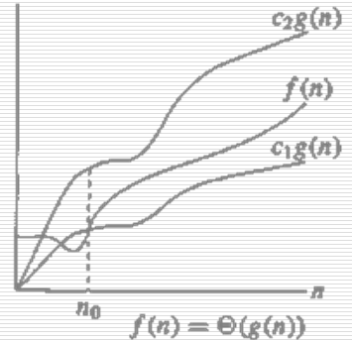
Theta Notation
Example
3n + 2 = Θ(n)
3n + 2 ≥ 3n for all n ≥ 2.
3n + 2 ≤ 4n for all n ≥ 2.
So, C₁ = 3, C₂ =4 & n₀ =2.
The function f(n) = Θ(g(n)) iff g(n) is both an upper and lower bound on the value of f(n).
The theta notation is more precise than both of the big oh and omega notations

Slide 35
Asymptotic Complexity
The asymptotic complexity (i.e. The complexity in terms of “Big Oh”, “Omega”, and “Theta”) can be determined quite easily without determining the step count.
This can be done by first determining the asymptotic complexity of each statement in the algorithm and then adding these complexities.

Slide 36
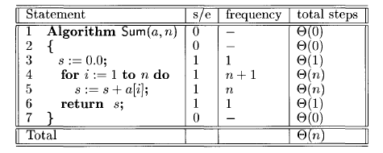
Asymptotic Complexity

Slide 37
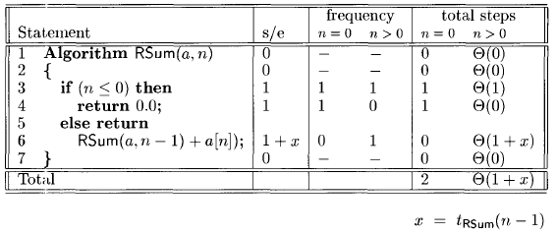
Asymptotic Complexity

Slide 38
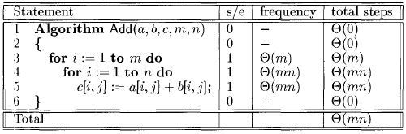
Asymptotic Complexity

Slide 39
Practical Complexities
The time complexities of an algorithm is generally some function of the instance characteristics.
This function is useful in determining how the time requirements vary as the instance characteristics change.
This function can also be used to compare two algorithms that perform same task.
Following table shows how the various functions grow with ‘n’.

Slide 40
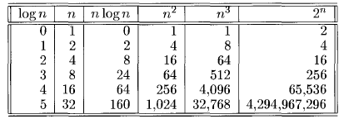
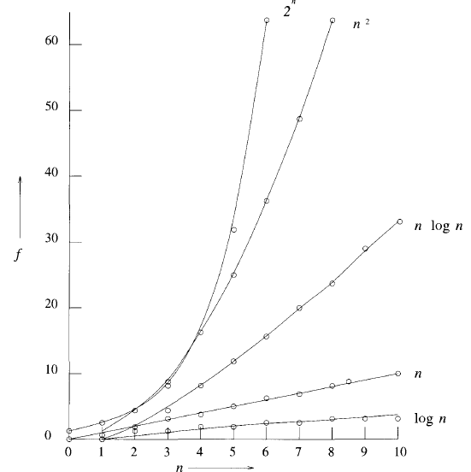
Practical Complexities- Function Values

Slide 41
Practical Complexities
Algorithms that have a complexity that is a polynomial of high degree are also of limited utility.
For example an algorithm needs n¹⁰ steps, then using our 1-billion steps-per second computer, we need
  10 seconds when n=10
  3171 years when n=100
  3.17 * 10¹³ years when n=1000
If the algorithm’s complexity had been n³ steps instead, then we would need
  One second when n=1000
  110.67 minutes when n=10,000
  11.57 days when n=100,000

Slide 42
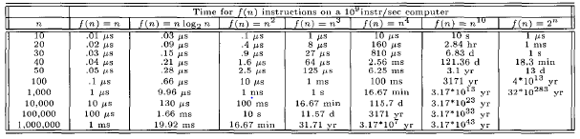
Practical Complexities
Times on a 1-billion steps- per second computer.

Slide 43
Performance Measurement
Performance measurement is concerned with obtaining the space and time requirements of a particular algorithm.
These quantities depend on
  the compiler and options used
  the computer on which the algorithm is run
The space and time needed for compilation is not considered.
Run –time space requirements of a program is not considered.
The focus is on measuring the computing time of a program.
Clocking procedure is required to obtain the computing time of a program.

Slide 44

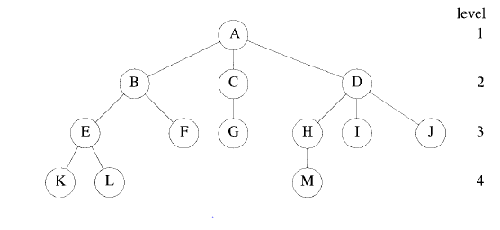
Trees

Slide 45
Terminologies of Trees
Root is at the top
The number of sub-trees of a node is called its degree.
  Degree of A is 3, of C is 1, and of F is 0
Nodes that have degree zero are called leaf or terminal nodes
The other nodes are referred to as nonterminals
The roots of the subtrees of a node X are the children of X; the node X is the parent of its children.

Slide 46
Terminologies of Trees
The degree of a tree is the maximum degree of the nodes in the tree.
  The tree in above figure has degree 3
Ancestors of a node are all the nodes along the path from the root to that node.
The level of a node is defined by initially letting the root be at level one
  If a node is at level p, then its children are at level p + 1;
The height or depth of a tree is defined to be the maximum level of any node in the tree.
A forest is a set of n>=o disjoint trees.
If we remove the root of a tree, we get a forest.

Slide 47
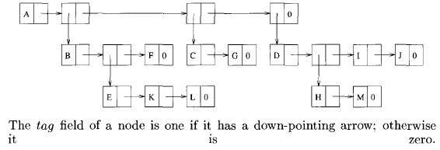
List Representation of The Tree
In this figure nodes have three fields; tag, data and link.
When tag = 1, data contains a pointer to a list rather than a data item.

Slide 48
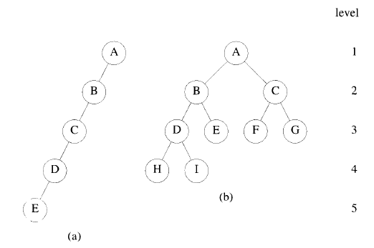
Binary Trees
A binary tree is a finite set of nodes that is either empty or consists of a root and two disjoint binary trees called the left and right sub-trees.
The tree shown in following figure (b) is called a complete binary tree.
The binary tree of depth k that has exactly (2^k) – 1 nodes is called a full binary tree of depth k.

Slide 49
Representation of Binary Tree in Array
If a binary tree with n nodes is represented sequentially in array, then for any node with index i , 1 ≤ i ≤ n, we have
  Root of the tree is at index 1.
  Parent(i) is at i/2 if i ≠ 1. when i=1, i is the root and has no parent.
  Lchild(i) is at 2i if 2i ≤ n. If 2i > n, i has no left child.
  Rchild(i) is at 2i+1 if 2i + 1 ≤ n. if 2i + 1 > n, i has no right child.
For example,
80
 | 1 | 2 | 3 | 4 | 5 | 6 | 7
a | 80 | 45 | 70 | 40 | 35 | 50 | 90
45
70
40
35
50
90

Slide 50
Priority Queues
Any data structure that supports the operation of search min (or max), insert and delete min (or max) is called a priority queue.
The simplest way to represent a priority queue is an unordered linear list.
If the list is represented sequentially, additions are most easily performed at the end of this list.
Hence, the insert time is (1).

Slide 51
Priority Queues
Suppose that we have n elements in this queue and the delete max operation is to be supported,
  A deletion requires a search for the element with the largest key followed by its deletion.
  Since it takes (n) time to find the largest element in an n-element unordered list, the delete time is (n).
An alternative is to use an ordered linear list.
The elements are in non decreasing order.
The delete time for each representation is (1).
The insert time is O(n).

Slide 52
Heaps
A max( or min) heap is a complete binary tree with the property that the value at the each node is at least as large as ( or as small as) the value at its children (if they exist).
This property is called heap property.
The definition of a max heap implies that the one of the largest elements is at the root of the heap.
If the elements are distinct, then the root contains the largest item.

Slide 53
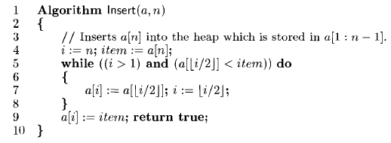
Algorithm for Insertion into a Heap

Slide 54
Action of Insert – inserting 90 into an Existing Heap
80
80
45
70
45
90
40
35
50
90
40
35
50
70
90
45
80
40
35
50
70

Slide 55
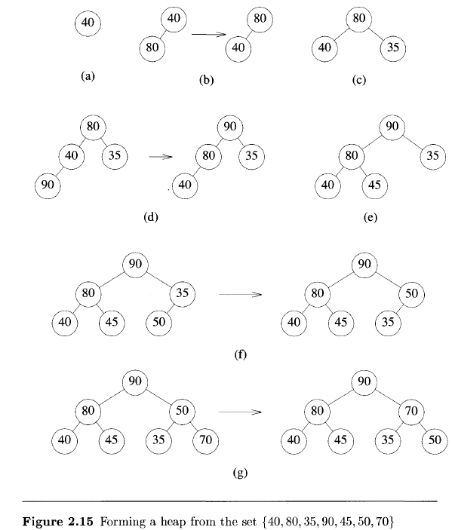
Forming a Heap from Given Set
Figure 2.15 shows how the given data move around until a heap is created.
Trees to the left of any “->” represent the state of the array a[1:i] before some call of Insert().
Trees of the right of any “->” show how the array was altered by Insert() to produce a heap.

Slide 56
Analysis of Insert(a,n)
In the best case, the new element is correctly positioned initially and no value need to be rearranged.
In the worst case, the no. of executions of the while loop is proportional to the no. of levels in the heap.
Thus, if there are n elements in the heap, inserting a new element takes (log n) time in the worst case.

Slide 57
Deletion of the maximum key from the max heap
To delete the maximum key from the max heap, Adjust() algorithm is used.
It takes as input the array a[] and integers i and n.
It regards a[1:n] as a complete binary tree.
If the subtrees rooted at 2i and 2i + 1 are already max heaps then adjust() will rearrange elements of a[] such that tree rooted at i is also a max heap.
The maximum element from the max heap a[1:n] can be deleted by deleting the root of the corresponding complete binary tree.
The last element of the array, i.e a[n] is copied to the root and finally Adjust (a,1,n-1) is called.

Slide 58
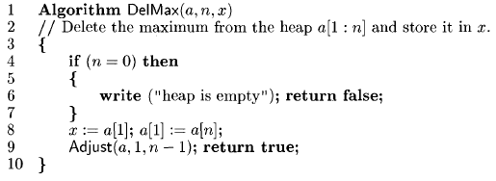
Algorithm DelMax(a, n, x)

Slide 59
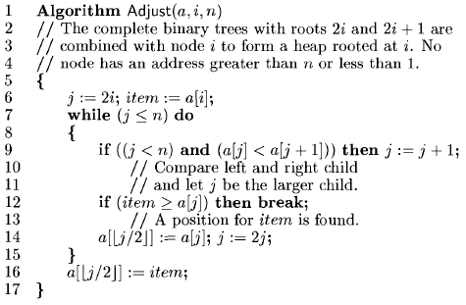
Algorithm Adjust(a, i, n)
The worst case run time of Adjust is proportional to height of the tree.
Therefore, if there are n elements in a heap, deleting the maximum can be done in O(log n) time.

Slide 60
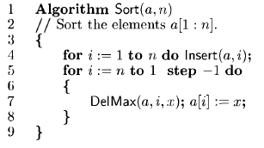
A Sorting Algorithm
To sort n elements, it suffices to make n insertions followed by n deletion from a heap.
Since insertion and deletion take O (log n) time each in the worst case, this sorting algorithm has a time complexity of O(n log n).

Slide 61
Heapify
It is possible to device an algorithm that can perform n inserts in O(n) time rather than O(n log n).
This reduction is achieved by an algorithm that regards any array a[1:n] as a complete binary tree and works from the leaves up to the root, level by level.
At each level, the left and right sub-trees of any node are heaps.
Given n elements in a[1:n], we can create a heap by applying Adjust().
Leaf nodes are already heaps.
We can begin by calling Adjust() for the parents of leaf nodes and then work up level by level, until the root is reached.

Slide 62

Algorithm Heapify
Trace the Algorithm Heapify for seven elements (100,119,118,171,112,151,132).
The initial tree is drawn in Fig. 2.16(a).
Since n=7, the first call to Adjust has i=3.
In fig. 2.16(b) the three elements 118, 151, 132 are rearranged to form a heap.
Subsequently Adjust is called with i=2 and i=1 (see trees 2.16 (c) and (d).

Slide 63
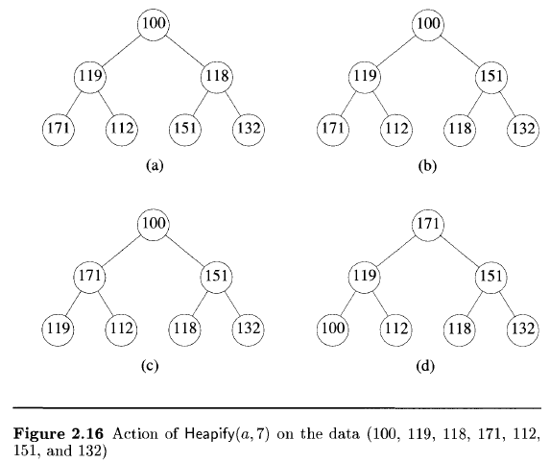
Action of Heapify(a,7)

Slide 64
Comparision of Heapify and Insert
Heapify() is faster in the worst-case which requires O(n) operations as compared with O(n log n) of Insert().
Heapify() requires that all the elements be available before heap creation begins. Whereas using Insert(), we can add a new element into the heap at any time.

Slide 65
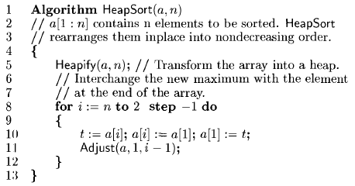
HeapSort

Slide 66
HeapSort
It is an application of heap for sorting
The call of Heapify requires O(n) operations.
Adjust requires O(log n) operations for each invocation.
thus, the worst-case time for HeapSort is O(n log n)
A number of other data structures can also be used to implement a priority queue. They are:
  Min heap
  Min-Max heap
  Deap
  Leftist tree
  Binomial heap
  Fibonacci heap
  2-3 tree
  Red-Black tree

Slide 67
Exercise Based on Heaps
Trace heapify() and heapsort() for a[20, 28, 15, 30, 4, 8, 2, 13, 18]

Slide 68
Sets and Disjoint Set Union
Forests can be used to represent sets.
The elements of the sets are the numbers 1,2,3,....,n.
These numbers might be indices into a symbol table in which the names of the elements are stored.
We assume that the sets being represented are pair-wise disjoint.
  If Si and Sj, i != j, are two sets, then there is no element that is in both Si and Sj

Slide 69
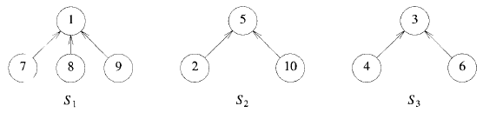
Representation of Sets using Forest
The operations which can be performed on these sets are :
  Disjoint Set Union: If Si and Sj are two disjoint sets, then their union Si U Sj = all elements x such that x is in Si or Sj .
    Thus, S1 U S2 = { 1,7,8,9,5,2,10}
    Once union is applied, Si and Sj are replaced by Si U Sj
  Find(i): Given the element i, find the set containing i.

Slide 70
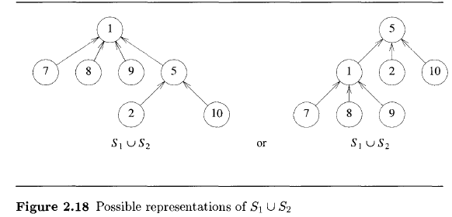
Union and Find Operations
To obtain union of S1 and S2 from previous figure, we make one of the trees a sub-tree of the other.
  set the parent field of one of the roots to the other root.

Slide 71
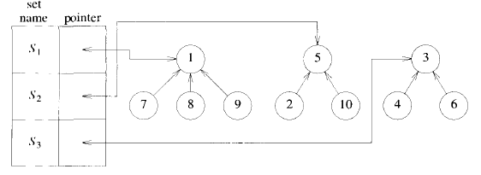

Data Representation for Sets
Since the set elements are numbered 1 through n, we represent the tree nodes using an array p[1 : n], where n is the maximum number of elements.

Slide 72
Union and Find
We can implement Find(i) by following the indices, starting at i until we reach a node with parent value -1.
For example, Find(6) starts at 6 and then moves to 6’s parent, 3.
Since p[3] is negative, we have reached the root.
To perform operation Union(i,j) we pass in two trees with roots i and j.
Adopting the convention that the first tree becomes a subtree of the second, the statement p[i] = j; accomplishes the union.

Slide 73
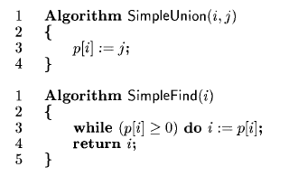
Simple Algorithms for union and find

Slide 74

Degeneration of a Tree
Now, consider n sets, each having 1 element.
Si = {i}, i=1,…,n
So, Parent(i)=0, for i=1,…,n
So, there are n trees with single node.
Now, consider the sequence of Union-Find operations as follows.
Union(1,2),Union(2,3),Union(3,4),…,Union(n-1,n),Find(1),Find(2),…,Find(n)
This will result in a degenerated tree as follows.
1
2
3
4
5
6
7
.
.
n

Slide 75
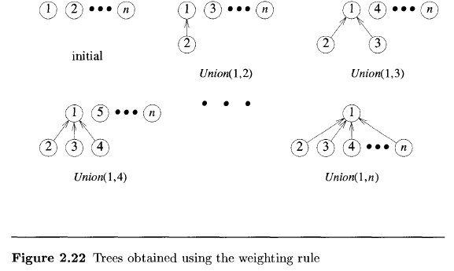
Weighting rule for Union(i,j)
If the number of nodes in the tree with root i is less than the number in the tree with root j, then make j the parent of i; otherwise make i the parent of j.

Slide 76
Algorithm Weighted Union
To implement the weighting rule, we need to know how many nodes there are in every tree.
  We maintain a count field in the root of every tree.
  If i is a root node, then count[i] equals the number of nodes in that tree.
  Since all nodes other than the roots of trees have a positive number in the p field, we can maintain the count in the p field of the roots as a negative number.

Slide 77
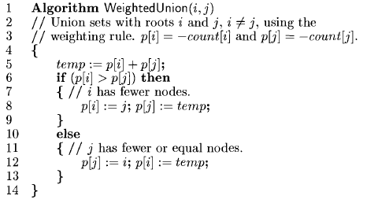
Algorithm Weighted Union

Slide 78
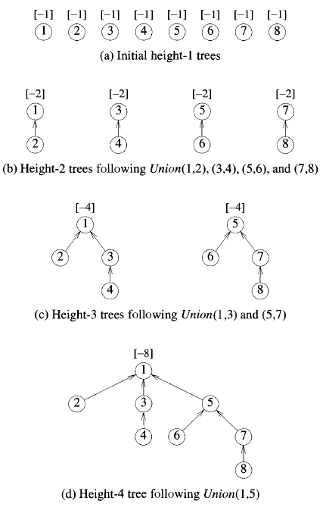
Behaviour of Weighted Union

Slide 79
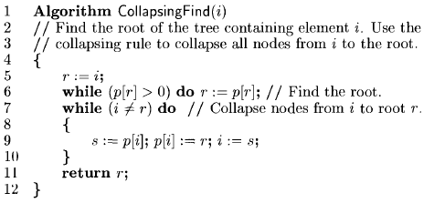
Collapsing Find
Collapsing Rule: If j is a node on the path from i to its root and p[i] ≠ root[i], then set p[j] to root[i].
Collapsing find algorithm incorporates the collapsing rule.

Slide 80
Divide and Conquer
Given a function to compute on n inputs the divide-and-conquer strategy suggests splitting the inputs into k distinct subsets, 1< k ≤ n, yielding k subproblems.
These subproblems must be solved, and then a method must be found to combine subsolutions into a solution of the whole.
If the subproblems are still relatively large, then D&Q strategy can be reapplied.
D&Q principle is naturally expressed by a recursive algorithm.
The problem is divided into subproblems until subproblems that are small enough to be solved without splitting are produced.

Slide 81
Divide and Conquer (DAndC)
DAndC algorithm is initially invoked as DAndC(P), where P is the problem to be solved.
Small(P) is a boolean-valued function that determines whether the input size is small enough that the answer can be computed without splitting.
  If this is so, the function S is invoked
  Otherwise, the problem P is divided into smaller subproblems.
The subproblems P1,P2,P3,...,Pk are solved by recursive applications of DAndC.
Combine is a function that determines the solution to P using the solutions to the k subproblems.

Slide 82
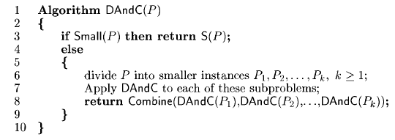
Divide and Conquer (DAndC)

Slide 83
Time Complexity of DAndC
If the size of P is n and the sizes of the k subproblems are n₁,n₂,…,n_{k}, respectively then computing time of DandC is determined by the recurrence relation
T(n) = g(n) …………if n is small
= T(n₁)+T(n₂)+…+T(n_{k})+ f(n) ………..otherwise
where,
    T(n) is time for DAndC on any input of size n
    g(n) is time to compute for small input n
    f(n) is time for dividing P and combining solution to subproblems
Complexity of DAndC is given by a recurrence relation of the form:
T(n) = T(1)…………….n=1
= aT(n / b) + f(n)…………n>1
where,
    a and b are known constants
    Assume that, T(1) is known and n is power of b (n=b ^{k})

Slide 84
Binary Search Technique
Let a_{i} be the list of elements that are sorted in nondecreasing order for 1 ≤ i ≤ n.
  We want to search an element x in the list.
  If x is present then we have to determine a value j such that a_{j}=x.
  If x is not present then j is set to zero.
Let the problem P=(n, a_{i},…, a_{l} , x)
where, n is no. of elements in the list a_{i},…,a_{l}
x is element to be searched.
Small(P) is true if n=1.

Slide 85
Binary Search Technique
If P has more than one element then we subdivide it by breaking it into smaller subproblems as follows:
  Let q, the index between range i to l.
  Compare x with a_{q}.
  There are three possibilities:
    If x = a_{q} then P is solved
    If x < a_{q} then search only a_{i}, …, a_{q-1,} & P(q-i, ai,…,a_{q-1},x)
    If x > a_{q} then search only a_{q+1},…, a_{l,} & P(l-q, a_{q+1}, a_{l},x)

Slide 86
Binary Search
The division of the problem P into a new subproblem takes time (1).
If q is always chosen such that a_{q} is the middle element (i.e q= (n+1) /2), then the resulting search algorithm is binary search.
The answer to the subproblem is also answer to the original problem P.
So, there is no need to combine the solution.

Slide 87
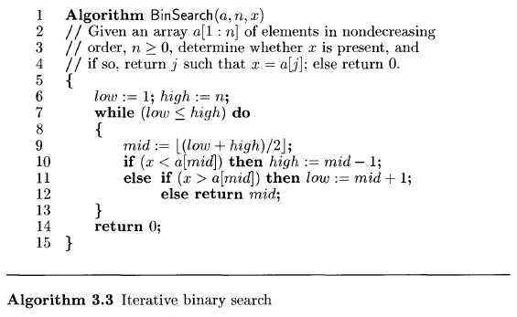
Binary Search

Slide 88
Example of Binary Search
Trace the algorithm
    a:[-15, -6, 0, 7, 9, 23, 54, 82, 101, 112, 125, 131, 142, 151]
    n= 14,
    x=142
Exercise
  Trace the algo. using the same array for the following values of x:
      x = 7
      x = -20

Slide 89
Time Complexity of Binary Search
Time required for
  Successful search
    Best case : (1)
    Average case : (log n)
    Worst case : (log n)
  Unsuccessful search
    All the cases : (log n)

Slide 90
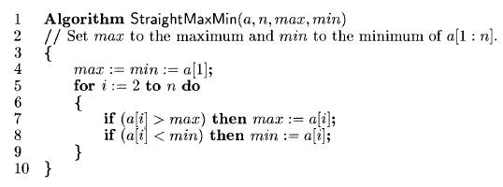
Finding Maximum and Minimum from Array
The problem is to find the minimum and maximum values in a set of n elements.

Slide 91
Analysis of StraightMaxMin
Number of comparisons required for best, average and worst case is 2(n-1).
For improvement, we can redesign for loop as follows:
{ if (a[i] > max) then max:=a[i];
else if (a[i] < min) then min:=a[i];
}
  This is because, the comparison (a[i] < min) is necessary only if (a[i] > max) is false.
Best case:
  Array is in ascending order.
  No. of comparisons required : (n-1)
Worst case:
  Array is in descending order.
  No. of comparisons required : 2(n-1)
Average case:
  No. of comparisons required < 2(n-1)
  More accurately it is (3n/2) -1

Slide 92
D&Q for finding Maximum and Minimum
Consider the problem as P = ( n , a[i],…,a[j])
  n is the number of elements in the list a[i],…,a[j]
  We are to find maximum and minimum from this list.
Let Small(P) be true when n <= 2
  If n = 1, maximum and minimum is a[i]
  If n = 2, the problem can be solved by using just one comparison.
If the array has more than two elements then
  divide P into smaller sub-problems as
    P1 = ( [n/2] , a[1],…,a[ n/2 ]) and
    P2 = (n – [n/2] ,a[ n/2 + 1],…,a[n]))
  Combine the solution as
    Max(P) = Max(Max(P1), Max(P2),…, Max(Pn))
    Min(P) = Min(Min(P1), Min(P2),…, Min(Pn))

Slide 93
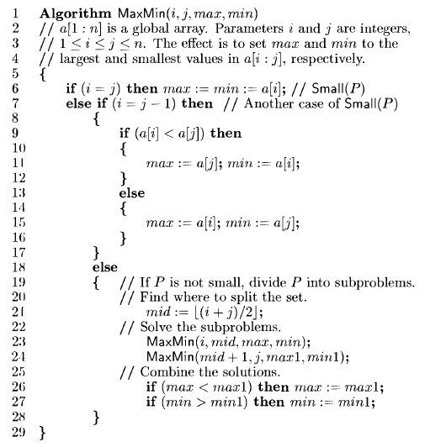
Algorithm MaxMin

Slide 94
Example of MaxMin
Array: [ 22,13, -5, -8, 15, 60, 17, 31, 47 ], n=9, MaxMin(1,9, , )
1 | 9
1 | 9 | 60 | -8
6 | 9
1 | 5
6 | 9 | 60 | 17
1 | 5 | 22 | -8
4 | 5
4 | 5 | 15 | -8
6 | 7 | 60 | 17
6 | 7
8 | 9
1 | 3
8 | 9 | 47 | 31
1 | 3 | 22 | -5
1 | 2
1 | 2 | 22 | 13
3 | 3
3 | 3 | -5 | -5

Slide 95

Performance of MaxMin
Number of elements comparison “T(n)” needed for MaxMin:
When n=2^{k} then (3n/2) -2 is the best, worst & average case number of comparison.
This is 25% saving in comparisons as compared with straightforward method.
In terms of storage, MaxMin is worse than straightforward method because it requires stack space for i,j,max,min,max1 & min1 for each recursive call.

Slide 96
Merge Sort
Merge sort is an example of D&C.
In the worst case, its complexity is O(n log n).
We assume that the elements are to be sorted in nondecreasing order.
The array of n elements a[1],…,a[n] is given.
Split the array in two sets
  a[1],…,a[n/2] &
  a[(n/2) + 1],…,a[n].
Each set is individually sorted & the resulting sorted arrays are merged to produce a single sorted array of n elements.

Slide 97
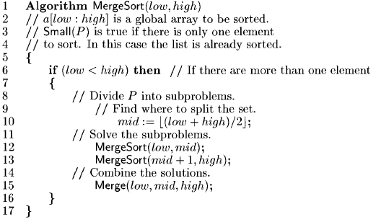
Algorithm MergeSort(low, high)

Slide 98
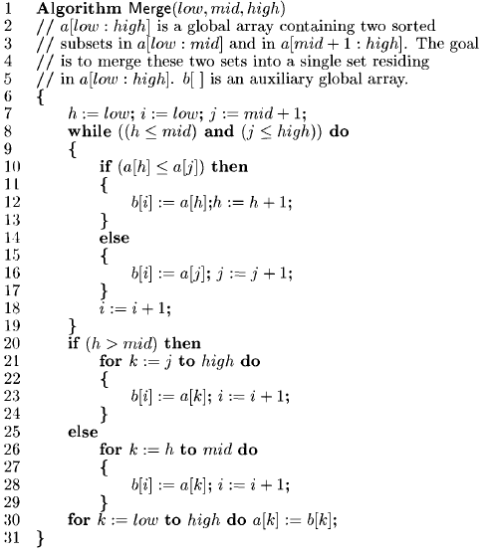
Algorithm Merge(low , mid, high)

Slide 99
Example of MergeSort
E.g. array : {18, 85, 79, 52, 51, 23, 61, 54, 50, 20}, n=10
Trace of calls for MergeSort(1,10)
1 | 10
1, 5
6, 10
1, 3
4, 5
6, 8
9, 10
1, 2
3, 3
4, 4
5, 5
6, 7
8, 8
9, 9
10, 10
1, 1
2, 2
6, 6
7, 7

Slide 100
Trace of Calls for Merge
1, 1, 2
6, 6, 7
1, 2, 3
4, 4, 5
6, 7, 8
9, 9, 10
1, 3, 5
6, 8, 10
1, 5, 10

Slide 101
Example of MergeSort
10 | 51 | 52 | 79 | 85 | 23 | 54 | 61 | 50 | 20
10 | 51 | 52 | 79 | 85 | 23 | 61 | 54 | 50 | 20
10 | 51 | 52 | 79 | 85 | 23 | 61 | 54 | 50 | 20
10 | 85 | 79 | 52 | 51 | 23 | 61 | 54 | 50 | 20
10 | 85 | 79 | 52 | 51 | 23 | 61 | 54 | 50 | 20
10 | 85 | 79 | 52 | 51 | 23 | 61 | 54 | 50 | 20
10 | 85 | 79 | 52 | 51 | 23 | 61 | 54 | 50 | 20
10 | 79 | 85 | 52 | 51 | 23 | 61 | 54 | 50 | 20
10 | 79 | 85 | 52 | 51 | 23 | 61 | 54 | 50 | 20
10 | 85 | 79 | 52 | 51 | 23 | 61 | 54 | 50 | 20
10 | 79 | 85 | 52 | 51 | 23 | 61 | 54 | 50 | 20
10 | 79 | 85 | 51 | 52 | 23 | 61 | 54 | 50 | 20
10 | 51 | 52 | 79 | 85 | 23 | 61 | 54 | 50 | 20
10 | 51 | 52 | 79 | 85 | 23 | 61 | 54 | 50 | 20
10 | 51 | 52 | 79 | 85 | 23 | 61 | 54 | 50 | 20
10 | 51 | 52 | 79 | 85 | 23 | 54 | 61 | 50 | 20
10 | 51 | 52 | 79 | 85 | 23 | 54 | 61 | 50 | 20
10 | 51 | 52 | 79 | 85 | 23 | 54 | 61 | 20 | 50
10 | 51 | 52 | 79 | 85 | 20 | 23 | 50 | 54 | 61
10 | 20 | 23 | 50 | 51 | 52 | 54 | 61 | 79 | 85
MergeSort(1,10)
MergeSort(1,5)
MergeSort(1,3)
MergeSort(1,2)
MergeSort(1,1)
MergeSort(2,2)
Merge(1,1,2)
MergeSort(3,3)
Merge(1,2,3)
MergeSort(4,4)
MergeSort(5,5)
Merge(4,4,5)
Merge(1,3,5)
MergeSort(6,10)
MergeSort(6,8)
MergeSort(6,7)
MergeSort(6,6)
MergeSort(7,7)
Merge(6,6,7)
MergeSort(8,8)
Merge(6,7,8)
MergeSort(9,10)
MergeSort(9,9)
MergeSort(10,10)
Merge(9,9,10)
Merge(6,8,10)
Merge(1,5,10)

Slide 102
MergeSort Execution
6 2 8 4
2 4 6 8
6 2 8 4 3 7 5 1
1 2 3 4 5 6 7 8
1 3 5 7
3 7 5 1
3 7 5 1
6 2
2 6
2 4 6 8
6 2 8 4
8 4
4 8
3 7 5 1
2 4 6 8
3 7
3 7
1 3 5 7
2 4 6 8
5 1
1 5
6 2
6
3 7
3
3
3 7
6
7
5
2 6
2
2
8 4
8
4 8
7
5 1
1 5
8
1
4 8
4
4
5
1 5
1
6
2
8
4
3
7
5
1

Slide 103
Exercise
Trace the algo. for
a[15, 90, 84, 57, 56, 58, 66, 59, 55, 25]
n=10,
low=1,
high=10

Slide 104
Quick Sort
In merge sort, the file was divided at its mid point into subarrays which were independently sorted and later merged.
In quicksort, the division into two subarray is made so that the sorted subarrays do not need to be merged later.
Merge sort requires separate array , quick sort does not require separate array (in-place algorithm).

Slide 105
Quick Sort
Quick sort can be implemented by rearranging the elements in a[1:n] such that
  a[i] ≤ a[j] for all i between 1 & m and
  all j between m+1 & n for some m where 1 ≤ m ≤ n.
The elements in a[1:m] and a[m+1:n] can be independently sorted. Therefore, no merge is needed.
The rearrangement of the elements is accomplished by picking some element of a[], say t = a[s] and then reordering of other elements so that
  all the elements appearing before t are less or equal to t, and
  all the elements appearing after t are greater or equal to t.
This rearrangement is referred to as partitioning.

Slide 106
Partitioning
Consider the following array of nine elements
The function is initially invoked as Partition (a, 1, 10)
The ends of the horizontal line indicate those elements which were interchanged to produce the next row.
The element a[1] = 65 is the partitioning element (pivot element) and it is eventually determined to be the fifth smallest element of the set.
Notice that the remaining elements are unsorted but partitioned about a[5] = 65.

Slide 107

Partitioning

Slide 108

Algorithm Partition

Slide 109

Algorithm QuickSort(p,q)

Slide 110
Exercise
Trace QuickSort algorithm for
A[65,70,75,80,85,60,55,50,45]

